Slide 1
Module 8: Developing Client Applications

Slide 2

Overview
Developing Clients with ADO.NET
Data Binding in .NET Framework 2.0

Slide 3
Lesson: Developing Clients with ADO.NET
What Is ADO.NET?
ADO.NET Enhancements in .NET Framework 2.0
Best Practices for ADO.NET

Slide 4

What Is ADO.NET?
Managed classes for data access
SqlConnection SqlCommand SqlParameter | DataSet SqlDataAdapter SqlDataReader
Use ADO.NET to:
Control detailed aspects of data access
Access data in multiple, diverse relational data sources
Make extensive use of data binding
Build reports that require fast access to row-based sets of data

Slide 5
ADO.NET Enhancements in .NET Framework 2.0
New features for SQL Server 2005
Asynchronous data access
Multiple active result sets (MARS)
Bulk copy operations
Batch updates
Notifications
Snapshot isolation mode
Support for SQL Server 2005 data types

Slide 6
Best Practices for ADO.NET
Task | Best Practices
Connecting | Optimize connection usage (open late, close early) Use connection pooling Use Windows authentication Store connection strings securely
Executing commands | Use stored procedures Use transactions appropriately
Retrieving data | Use DataSet or SqlReader to return multiple rows Use SqlReader or output parameters for a single row Use ExecuteScalar or an output parameter for a single value
Modifying data | Use ExecuteNonQuery for connected/pessimistic scenarios Use DataSet for disconnected/optimistic scenarios

Slide 7

Practice: Using ADO.NET
In this practice, you will use ADO.NET to
Perform asynchronous data access operations
Use MARS
Perform a bulk copy operation
Perform batch updates
Use notifications
Use snapshot isolation mode

Slide 8
Lesson: Data Binding in .NET Framework 2.0
What Is Data Binding?
Data Binding in Windows Applications
Data Binding in ASP.NET 2.0 Applications

Slide 9

What Is Data Binding?
Multi-record data binding
Single-value data binding
ProductID
Name
Price
Red Bike
1
Red Bike
299.99
Discontinued?
2
Blue Bike
299.99
✓

Slide 10

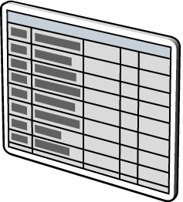
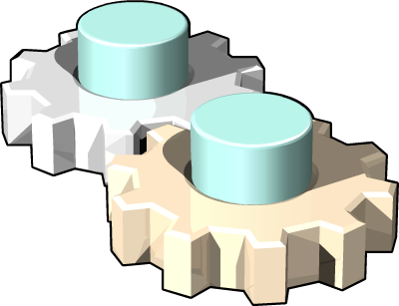
Data Binding in Windows Applications
SQL Server
Data Source
Data Component
DataConnector
ProductID
Name
Price
1
Red Bike
299.99
2
Blue Bike
299.99
Data bound controls

Slide 11




Data Binding in ASP.NET 2.0 Applications
<xml>
XML File
Custom Object
Access Database
Site Map
XmlDataSource
ObjectDataSource
AccessDataSource
SiteMapDataSource
SqlDataSource
DataSetDataSource
Data Bound Control
RDBMS
XML DataSet
ASP.NET Page

Slide 12

Lab 8: Developing Client Applications
Exercise 1: Creating a Data-Bound Windows Application
Exercise 2: Creating a Data-Bound ASP.NET Application

